Slide 1
Islamic Ethical Perspectives on
Human Genome Editing
Mohammed Ghaly (mghaly@hbku.edu.qa)
Professor of Islam and Biomedical Ethics
Research Center for Islamic Legislation & Ethics (CILE)
College of Islamic Studies (CIS)
Hamad Bin Khalifa University (HBKU), Qatar

Slide 2

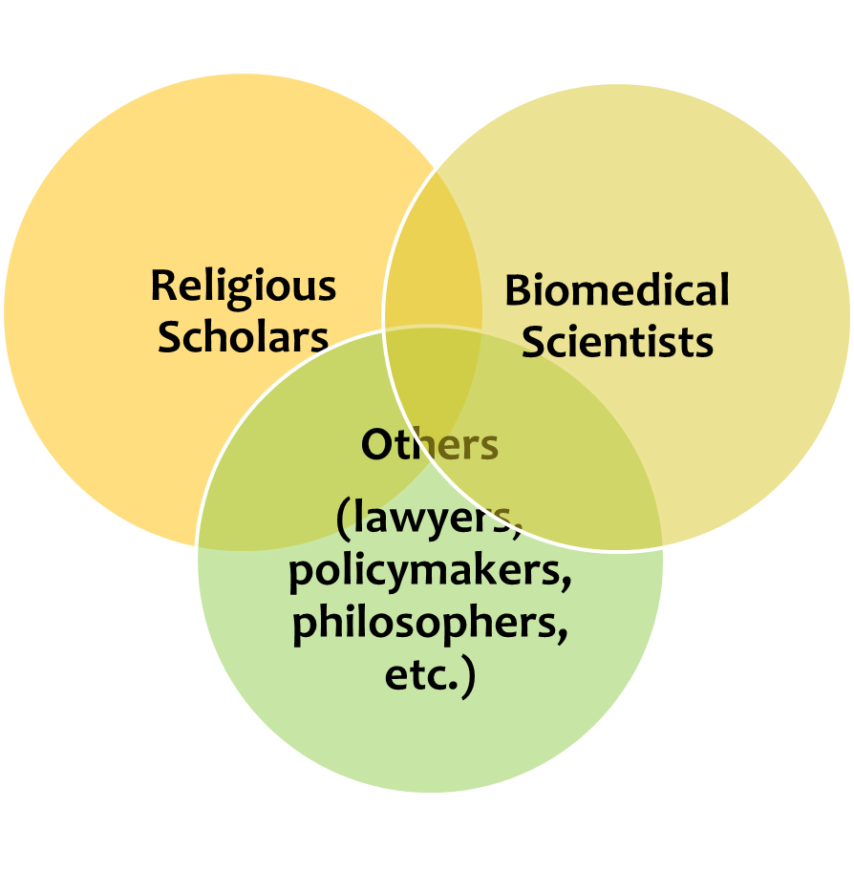
Interdisciplinary Discussions

Slide 3







Institutionalization
The Islamic Organization
for Medical Sciences (IOMS)
1984
Kuwait.
The Islamic
Fiqh Academy (IFA)
1977
Mecca
Saudi Arabia.
The International
Islamic
Fiqh Academy (IIFA)
1981
Jeddah
Saudi Arabia.

Slide 4
Human Genome Editing
Due respect for human dignity: Safety and efficacy, informed consent
(1) What? (Somatic Vs. Germline)
  Somatic Cells: more acceptable
    Treatment tool
    Limited scope: individual
  Germline Cells: more controversial
    Human intervention
    Impact on offspring: Authority over one’s body
    Disturbing lines of lineage

Slide 5
Human Genome Editing
(2) Why (telos of medicine)
  Treatment: morally permissible/recommended
    Part of the divine scheme of creation
    Alternative?
  Enhancement: Controversial
    Fixed Perfect OR changeable and improvabe
      “We have created man in the best composition” (Q. 95:04)
      He adds to creation whatever He wills (Q. 35:01)
    Editing body or soul?

Slide 6







No One-Fits-All Approach
Acceptable
Somatic Cell/Treatment
Controversial
Germline Cell/Treatment
Problematic
Germline Cell/Enhancement

Slide 7
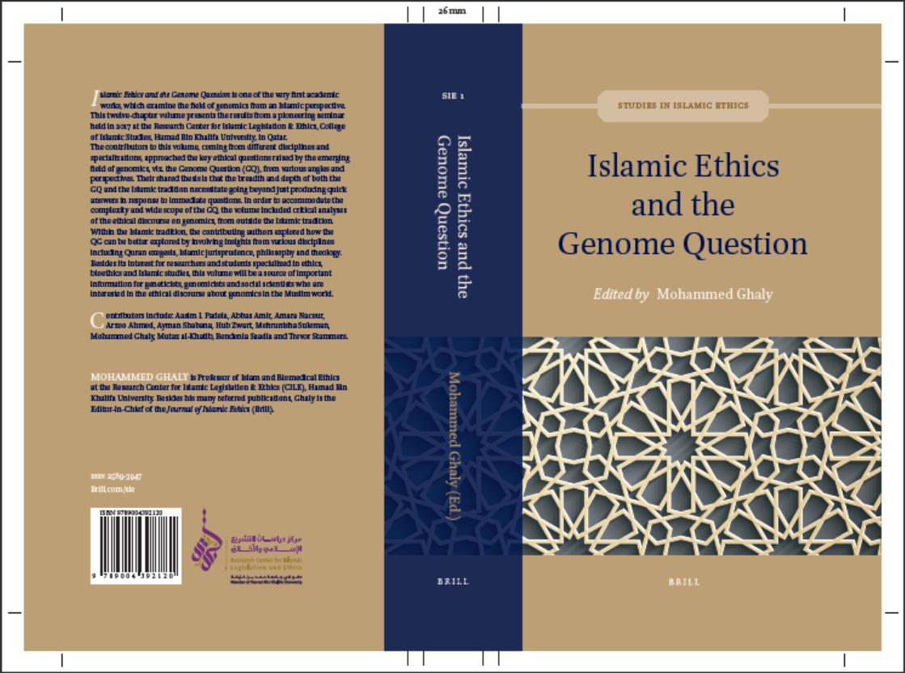

Slide 8
